Slide 1







🚜 Automated Weed Remover System Using Solar Energy 🌿
Vertex Innovate
K.Harshitha
K.Deepika
A.Chenna Kesava
M.Niharika
M.Pramod
K.Sumanth

Slide 2
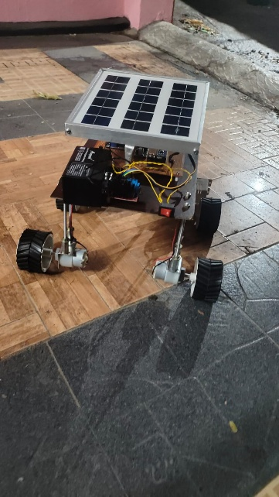
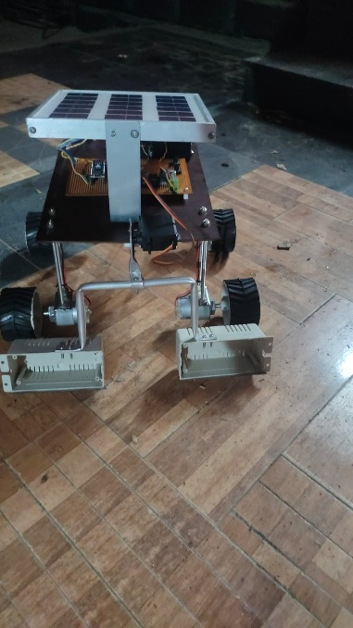

Index
Challenge Statement
Concept of the Solution
Novelty / Scope of Solution
Pros and Cons of the solution
Technical Description
Implementation Plan
Validation/Testing/Analysis
Cost Estimate
Assumptions
References

Slide 3
Challenge Statement
Weeds vie for resources (light, nutrients, water), lowering crop yields.
Physical weeding is time-consuming and inefficient on large farms.
Chemical herbicides are expensive and environmentally damaging.
Current robotic solutions are pricey and use non-renewable power.
Chemical herbicides are environmentally damaging, pollute soil and water, and lead to herbicide-resistant weed populations.
Current robotic weeders are pricey, so beyond the reach of small and mid-size farmers.
00001

Slide 4
Concept of the solution
A sun-powered robot that wearily eliminates weeds in between crop rows.
Stores power in a rechargeable battery to run indefinitely.
Utilizes sensors to navigate and sense obstacles.
Automatically changes rows and reports completion with alerts.
Autonomous navigation system uses GPS, LiDAR, and sensors to travel in between rows and navigate around obstacles.
Smart connectivity provides real-time monitoring, remote control, and data analysis through a mobile or web app.
Adaptive weed control modes vary intensity according to weed population and crop type
00001

Slide 5
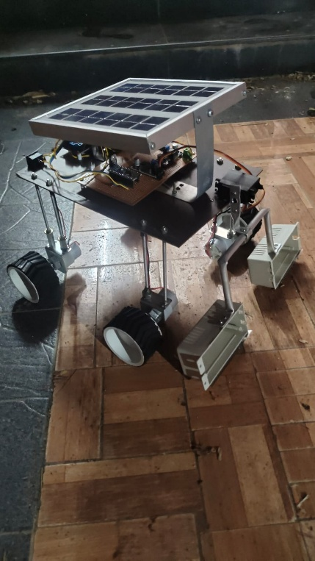
Novelty / Scope of Solution
Differing from high-priced robotic solutions, our solution is inexpensive & sustainable.
Employes pre-established rules to navigate, minimizing dependence on high-cost AI.
Environment friendly – No chemical herbicides needed.
Future Scope:
AI-driven intelligent weed recognition.
Variation for various farm sizes & types.
Wireless connectivity for real-time observation.
00001

Slide 6
Pros and Cons of the solution
✅ Pros:
Eco-Friendly & Sustainable – Deploys solar power to minimize dependence on fossil fuels.
Cost-Effective in the Long Run – Since installed, automated solar reduces manpower and fuel costs.
Reduces Chemical Usage – Does away with herbicides to make agriculture organic.
❌ Cons:
High Initial Investment – Solar panels, AI, and robots can cost a lot of money.
Weather Dependence – Rainy days or cloudy conditions can lower performance unless supported with batteries.
Maintenance Challenges – Requires regular maintenance to avoid mechanical breakdown and maintain efficiency.
00001

Slide 7
Technical Description
1.Control System:
Arduino Uno : Handles motor control and sensor processing.
Motor Drivers(L298N & L293D):Manages wheel and blade control.
2.Navigation System:
IR Sensors:Navigates the robot through crop rows.
3.Power System:
Solar Panel:Converting sun rays into energy.
Battery and Charging Module : Storing and powering.
4.Weeding Mechanism :
Harrow blades:Fixed at the rear to remove weeds as it moves
00001

Slide 8
Implementation Plan
Step-by-Step Execution Plan:
Research & Design – Examine current methods & design system architecture.
Component Selection & Procurement – Select & procure sensors, motors, solar panels.
Hardware Assembly– Construct the robot frame & assemble components.
Software Development – Code Arduino for navigation & automation.
Testing & Debugging – Test for proper functionality prior to deployment.
Field Deployment & Optimization– Deploy on actual farms & optimize performance.
00001

Slide 9
Validation / Testing / Analysis
Ensuring Reliability Before Deployment:
Simulation Testing: Test software algorithms in a simulated setup.
Lab Testing: Test motor control, power efficiency, and sensor accuracy.
Field Testing: Test in actual farms, record weed removal efficiency.
Performance Metrics:
Navigation & row switching success rate.
Solar charging efficiency & battery life.
Weed removal percentage effectively.
00001

Slide 10
Cost Estimate
Estimated Cost Breakdown:
Arduino Uno: ₹2075 Rechargeable Battery: ₹3320
IR Sensors (2 pcs): ₹830 Harrow Blade: ₹1660
Ultrasonic Sensor: ₹1245 Miscellaneous : ₹2490
L298N Motor Driver: ₹830 Solar Panel: ₹4150
L293D Motor Driver: ₹830 Gear Motors (2 pcs): ₹2490
Total Estimated Cost: ₹19920
00001

Slide 11
Assumptions
Solar-Powered & Energy Efficient – The system primarily runs on solar power, with a battery backup for low-light situations.
AI-Based Weed Detection – Employs computer vision and sensors to distinguish weeds from crops, allowing for accurate removal.
Autonomous & Safe Navigation – Fitted with GPS, sensors, and AI path planning to navigate fields while avoiding obstacles.
Mechanical Weed Elimination – Removes weeds through rotary blades, robotic grippers, or other non-chemical means, being environmentally friendly.
Weather & Terrain Flexibility – Made to operate on different types of soil and be resistant to moderate rain, dust, and heat.
Remote Monitoring & Control – Farmers are able to monitor, control, and monitor performance through a mobile or web interface.
00001

Slide 12
References
Automated weed control in Agriculture .
Solar-Powered Agricultural Robots.
Smart weeding System for Precision Agriculture.
Autonomous Navigation in Agricultural Robotics.
00001

Slide 13
Thank You
00001

